Slide 1
Randomized algorithms 4 Linear programming
CS240 Spring 2021
Rui Fan

Slide 2
Linear programming
A farmer has the following problem.
He has 100 acres of land, on which he can plant wheat or barley or both.
He has 420 kg of fertilizer, and 160 kg of pesticide.
Each acre of barley requires 5 kg of fertilizer and 1 kg of pesticide.
Each acre of wheat requires 3 kg of fertilizer and 2 kg of pesticide.
Wheat sells for $3 per acre, barley sells for $4 per acre.
Actually, he could probably make $300 for wheat and $400 for barley. Choose $3 and $4 for simplicity.
How many acres of wheat and barley should the farmer plant his field to maximize his income?
Let w, b be acres of wheat and barley farmer plants.
He wants to maximize 3w+4b, subject to the land, pesticide and fertilizer constraints.

Slide 3
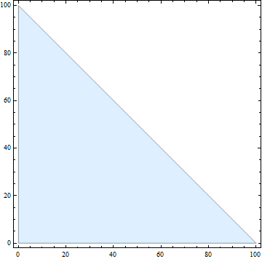
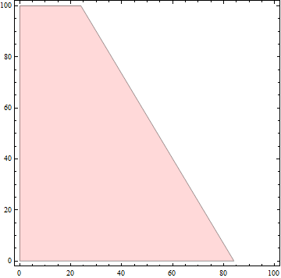
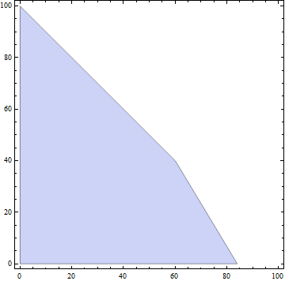
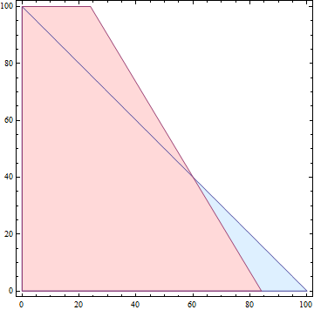
Linear programming
maximize 3w+4b subject to
w+b ≤ 100 (land)
3w+5b ≤ 420 (fertilizer)
2w+b ≤ 160 (pesticide)
land constraint
fertilizer constraint
land + fertilizer constraints

Slide 4
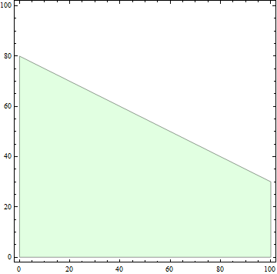
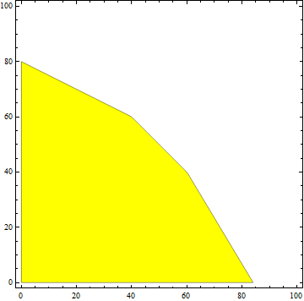
Linear programming
maximize 3w+4b subject to
w+b ≤ 100 (land)
3w+5b ≤ 420 (fertilizer)
2w+b ≤ 160 (pesticide)
land + fertilizer constraints
pesticide constraints
all three constraints

Slide 5
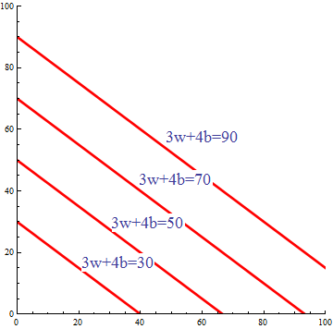
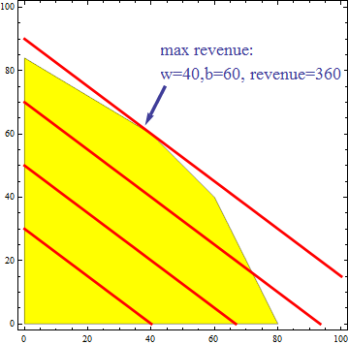
Linear programming
maximize 3w+4b subject to
w+b ≤ 100 (land)
3w+5b ≤ 420 (fertilizer)
2w+b ≤ 160 (pesticide)

Slide 6
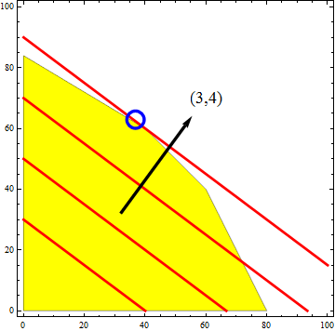
Linear programming
The feasible region is the area corresponding in which all the constraints are satisfied.
Key Fact The optimum lies at an extreme point (corner).
Find optimum by taking a line perpendicular to the direction pointed by the objective function, and shifting the line till when it will stop touching the feasible region.
The optimum lies at the intersection of two constraints.
Call these the basis of the optimum.
For simplicity, assume constraints are general position, i.e. no 3 intersect at a point.

Slide 7
Randomized LP in 2D
tight
c
Since the optimum is defined by two constraints, the other constraints are redundant!
A constraint is tight if it the optimum lies on its defining line.
Let H be set of n constraints. If pick random constraint, there’s only 2/n probability it’s tight.
If constraint’s not tight, we can discard it without changing optimum.
How do we tell if it’s tight?
For any constraint set G, let B(G) denote optimum.
h∈H is redundant iff B(H)=B(H-{h}).
I.e. the optimum is the same with or without h. So opt doesn’t lie on h.
redundant

Slide 8
2D LP algorithm
If |H|=2, output intersection of the 2 halfplanes.
Pick random constraint h∈H.
Recursively find opt=B(H-{h}).
If opt doesn’t violate h, output opt.
opt violates h if opt lies outside h.
Else project H-{h} onto h’s boundary to obtain a 1D LP.
Output the opt of the 1D LP.

Slide 9
Projection
c
h
Given constraint h, let ∂(h) be its boundary, i.e. the line defining h.
Suppose B(H-{h}) violates h.
Then B(H) must lie on the boundary of h.
Project a halfplane onto ∂(h), reducing it to a line segment bounded on one or two sides.
After projecting all H-{h} onto ∂(h), we’re left with a segment representing feasible region to 1D LP.
Optimizing this is easy. The opt is one of the endpoints.

Slide 10
Analysis
Let T(n) be expected time to solve 2D LP with n constraints.
T(n) ≤ T(n-1)+O(1)+2/n(O(n)+O(1)).
T(n-1) time recursively find opt=B(H-{h}).
First O(1) is time to check whether opt violates h.
There’s 2/n probability opt violates h, in which case we project all constraints onto ∂(h).
O(n) to project H-{h} onto ∂(h).
Final O(1) to solve 1D LP.
T(n) solves to O(n).
So we can solve 2D LP with n constraints in expected linear time.

Slide 11
Corner cases
For simplicity, we ignored several corner cases.
Infeasible means no points satisfy all the constraints.
Ex Constraints x₁>1 and x₁<0.
Unbounded means the optimum is infinite.
Ex Maximize x₂ s.t. x₁+x₂>0.
Non-unique optimum means an infinite number of points maximize the objective.
Ex Maximize x₂ s.t. x₂ ≤ 0.
Preprocess input to check for corner cases.
c
Infeasible
Unbounded
Non-unique optimum
http://www.cse.yorku.ca/~andy/courses/6114/Slides/CG5-LP.pptx

Slide 12
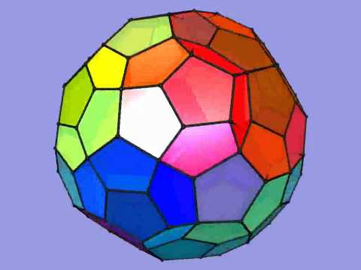
Higher dimensions
z
In d>2 dimensions, lines become planes and each constraint corresponds to the space to one side of a plane, called a halfspace.
The intersection of the halfspaces defines the feasible region.
This is a convex region called a polytope.
Each extreme point (corner) of the polytope is the intersection of d halfspaces.
The objective function defines a direction. Take a plane perpendicular to this direction and shift it till it stops touching feasible region.
Hence optimum again lies at intersection of d halfspaces.
Polytopes can be very complicated.
c
y
x
opt

Slide 13
d-Dimensional LP algorithm
If |H|=d, output their intersection.
Pick random constraint h∈H.
Recursively find opt=B(H-{h}).
If opt doesn’t violate h, output opt.
Else project H-{h} onto h’s boundary to obtain a d-1 dimensional LP.
Recursively solve the d-1 dim LP.

Slide 14
Analysis
Let T(n,d) be expected time to solve d-dim LP with n constraints.
T(n,d) ≤ T(n-1,d)+O(d)+d/n(O(dn)+T(n-1,d-1)).
T(n-1,d) time recursively find opt=B(H-{h}).
O(d) time to check whether opt violates h.
There’s d/n probability opt violates h.
Because opt is defined by d of the n halfspaces.
In this case we project all constraints onto ∂(h).
O(dn) to project H-{h} onto ∂(h).
We obtain a d-1 dim LP with n-1 constraints.
T(n-1,d-1) time to solve this.
T(n,d) solves to O(d! n)
Linear in number of constraints.
Exponential in dimensions.

Slide 15
Matrix formulation
n
maximize 3w+4b subject to
w+b ≤ 100
3w+5b ≤ 420
2w+b ≤ 160
c
x
x
≤
b
m
A

Slide 16
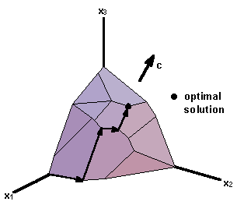
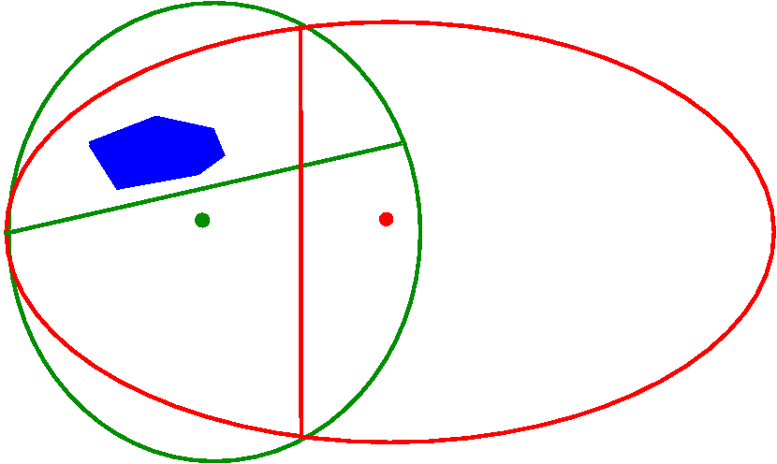
Deterministic LP algorithms
Simplex method (Dantzig 1947)
Optimum lies at the farthest corner in direction of c.
Walk along boundary of polytope in directions that improve c.
Number of steps can be exponential in worst case.
But works fast in practice.
Ellipsoid method (Khachiyan 1979)
First polynomial solution.
Interesting mostly in theory.
Interior point method (Karmarker 1984)
Practical polynomial method.

Slide 17
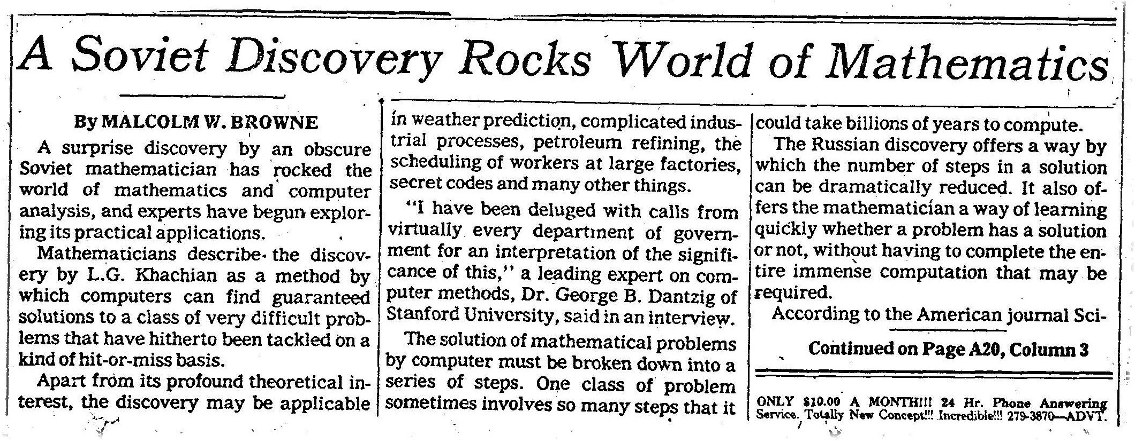
Applications of LP
Linear programming is one of the most important and widely used algorithms in the world.
NY Times, Nov. 27, 1979

Slide 18
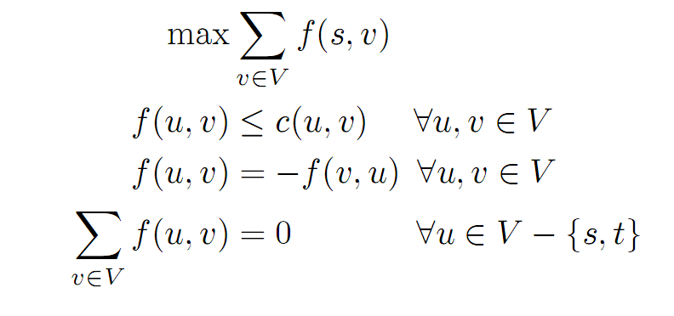
Applications of LP: Network flow
However, it’s more efficient to solve max flow using e.g. Dinic’s algorithm than more general LP algorithms.
total flow
capacity constraints
flow symmetry
conservation of flow at u

Slide 19
Approximation algorithms 1 Set cover

Slide 20

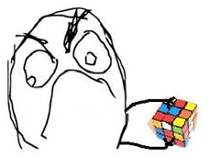


Approximation algorithms
Up to now, most of our algorithms have been exact. I.e. they find an optimal solution.
But there are many problems for which we don’t know how to find an optimal solution.
A key example is NP-complete problems. We don’t know efficient algorithms for any NPC problem.
Many such problems are important in practice. What do we do?
If we can’t get find the best answer, let’s try for good enough.
Approximation algorithms find an approximately optimal answer.

Slide 21
Approximation ratio
Let X be a maximization problem. Let A be an algorithm for X.
Let α>1 be a constant.
A is an α-approximation algorithm for X if A always returns an answer that’s at least 1/α times the optimal.
Ex If X is max-flow, A is a 2-approx algorithm if it always returns a flow that’s at least ½ the optimal.
The closer α is to 1, the better the approximation.
If X is a minimization problem, A is an α-approximation algorithm for X if it always returns an answer that’s at most α times larger than the optimal.
Ex If X is min-cut, A is a 2-approx algorithm if it always returns a cut that’s at most 2 times the size of the optimal.
Again, the closer α is to 1, the better the approximation.

Slide 22
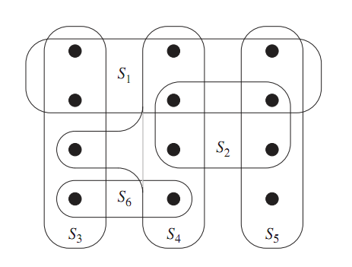
Coverings
Suppose there’s a set of teachers, and each can teach a certain set of classes.
Let S_{i} be the set of classes teach i can teach.
The entire set of classes is X.
We want to pick the minimum set of teachers to teach all the classes.
Let T be set of teachers we pick.
We want U_{i∈T} S_{i}=X, and T to be the smallest possible.

Slide 23
Set covering
Input A collection F of sets. Each set has a cost. The union of all the sets is X.
Output A subset G of F, whose union is X.
Goal Minimize the total cost of the sets in G.
Minimum cost set cover is NP-complete.
We’ll see a ln(n)-approximation algorithm, where n=|X|.
If all sets have same cost, S₃, S₄ and S₅ is a min cost set cover of X.

Slide 24
A greedy approximation alg
A natural greedy heuristic is to choose sets which cover points most cheaply.
For each set, let c be its cost, and m be the number of points it covers.
We want to use the set with the smallest c/m value, because this is the cheapest way to cover some new points.
After we pick this set, remove all the points it covers. Then we consider the per unit cost of the remaining sets and again choose the cheapest.

Slide 25
A greedy approximation alg
F is the entire collection of sets. The union of these sets is X.
Each set S in F has a cost cost(S).
U is the set of elements of X we haven’t covered yet.
C is the set cover we eventually output.
U = X
C = ∅
while U≠∅
choose S∈F-C with min |cost(S)|/|S∩U|
C = C∪{S}
U = U – S
output C
Per unit cost to cover new elements.

Slide 26
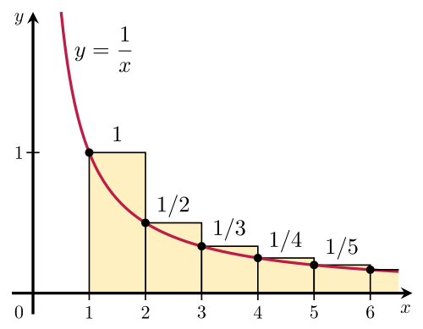
Proof of correctness
We always output a set cover, because the while loop continues till X is covered.
We’ll prove the approximation ratio is at most 1+1/2+1/3+...+1/n ≈ ln(n).
If the min cost of a set cover is V, our set cover costs at most ln(n)*V.
The basic plan is to bound the cost of the set cover the algorithm outputs using the “average cost” per element.

Slide 27
Proof of correctness
Order the sets in C by when they’re added to C, earliest set first.
Let the order be S₁, S₂,...,S_{m}.
Cost of the set cover is L=Σ_{i} cost(S_{i}).
Order the elements in X by when they’re added, earliest element first.
Let the order be e₁, e₂,...,e_{n}.
So, the first few e’s are added by S₁, the next few added by S₂, etc.
Every element in X is in the list, because C covers X.

Slide 28
Proof of correctness
Let n_{i} be the number of new elements S_{i} covers.
So, n_{i} is the number of elements in S_{i}, but not in S₁,...,S_{i-1}.
Divide the cost of S_{i} evenly among the new elements it covers.
If e is newly covered by S_{i}, then cost(e)= cost(S_{i})/n_{i}.
Σ_{k} cost(e_{k}) = Σ_{i} n_{i *}cost(S_{i})/n_{i} = Σ_{i} cost(S_{i}) = L.
Every element is covered by some S_{i}, and S_{i} covers n_{i} new elements.
We’ll prove cost(e_{k}) ≤ OPT/(n-k+1), for any k.
Suppose this is true, then
L = Σ_{k} cost(e_{k}) ≤ Σ_{k} OPT/(n-k+1) ≈ ln(n)*OPT

Slide 29
The per element cost
Let’s focus on some element e_{k}, and let S_{j} be the set which covers e_{k} for the first time.
Let C₁,...,C_{m} be the sets in an optimal cover, each of which covers some elements of U= {e_{k},e_{k+1},e_{k+2},...,e_{n}}.
Let n’₁,...,n’_{m} be the number of elements of U which C₁,...,C_{m} cover.
Obs 1 Σ_{i} n’_{i} ≥ n-k+1.
Because C₁,...,C_{m} cover U.
Obs 2 Σ_{i} cost(C_{i}) ≤ OPT.
Because C₁,...,C_{m} are a subset of an optimal cover, which has cost OPT.

Slide 30
The per element cost
Obs 3 None of C₁,...,C_{m} are among S₁,...,S_{j-1}.
If some C_{i} is among S₁,...,S_{j-1}, then since C_{i} covers some e in U, e would be covered by {S₁,...,S_{j-1}}. So, e would be among the first k-1 elements covered. Contradiction.
Obs 4 There exists some C_{i} among C₁,...,C_{m} with cost(C_{i})/n’_{i} ≤ OPT/(n-k+1).
If every C_{i} in C₁,...,C_{m} has cost(C_{i})/n’_{i}>OPT/(n-k+1), then
OPT ≥ Σ_{i} cost(C_{i}) = Σ_{i} n’_{i}*cost(C_{i})/n’_{i} >
Σ_{i} n’_{i}*OPT/(n-k+1) ≥ OPT/(n-k+1) Σ_{i} n’_{i} ≥
OPT/(n-k+1)*(n-k+1) = OPT.
Contradiction.

Slide 31
Proof of approximation ratio
Lemma cost(S_{j})/n_{j} ≤ OPT/(n-k+1).
Proof When choosing S_{j}, the only sets the algorithm is not allowed to choose are S₁,...,S_{j-1}.
By obs 3, C₁,...,C_{m} aren’t in S₁,...,S_{j-1}.
By obs 4, there’s some C_{i} in C₁,...,C_{m}, with cost(C_{i})/n’_{i} ≤ OPT/(n-k+1).
S_{j} was chosen so that cost(S_{j})/n_{j} is min among all sets not in S₁,...,S_{j-1}.
So cost(S_{j})/n_{j} ≤ cost(C_{i})/n’_{i} ≤ OPT/(n-k+1).
Since cost(S_{j})/n_{j} =cost(e_{k}), we have cost(e_{k})≤ OPT/(n-k+1).
The approx ratio follows because
L = Σ_{k} cost(e_{k})=Σ_{k} OPT/(n-k+1) ≈ ln(n)*OPT

